Slide 1
The Battle of Montmorency
By Loz Mckenzie, Matthew Latterell and Eden Whitaker
Notes:
Title Slide: Loz and Matthew did this

Slide 2
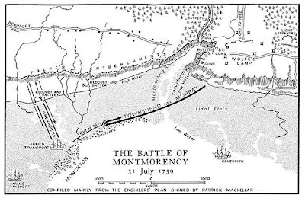
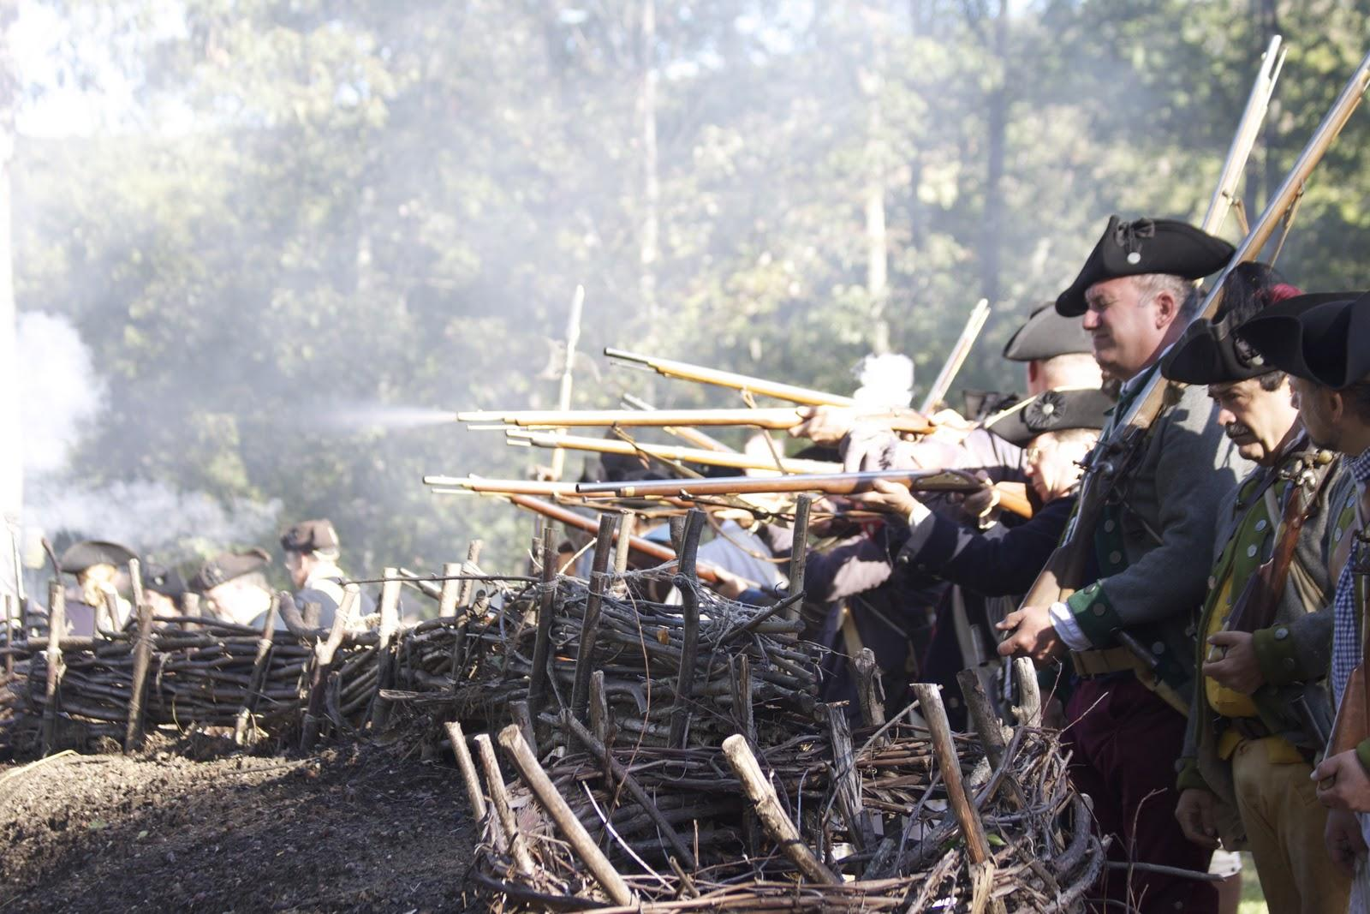
Why was The Battle of the Montmorency Fought
The Battle of Beauport was fought during the Seven Years War also known as the French and Indian war took place when on July 31 when Wolfe and his troops launched the invasion of Quebec
To capture a French Redoubt and draw Montclaim out.
General Wolfe realized that even if he captured the French redoubt it would be soon quickly retaken by the enemy side which is Louis‑Joseph de Montcalm.
This operation would die shortly
After losing 440 the British Surrendered which gave the French one of the greatest victories ever.
Notes:
Loz did this slide

Slide 3
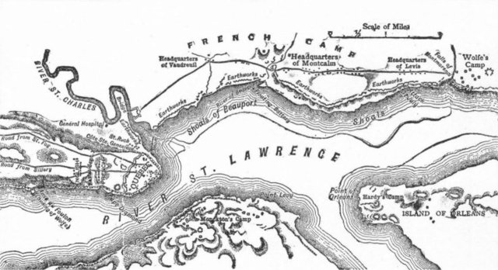
Who attacked first?
The Battle of Montmorency also known as the Battle of Beauport, was the first attack on Montmorency waged by the the British.
It was a British attack against the French line of defense called Beauport. The attack was on the morning of Tuesday July 31st as the British launched the invasion of Quebec to capture a French barrier but the French were ready and surprised them as they attacked with Canadian militia to.
Notes:
Matthew did this slide

Slide 4
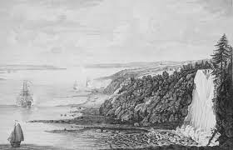
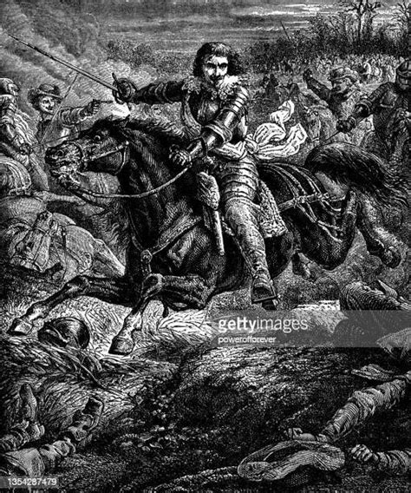
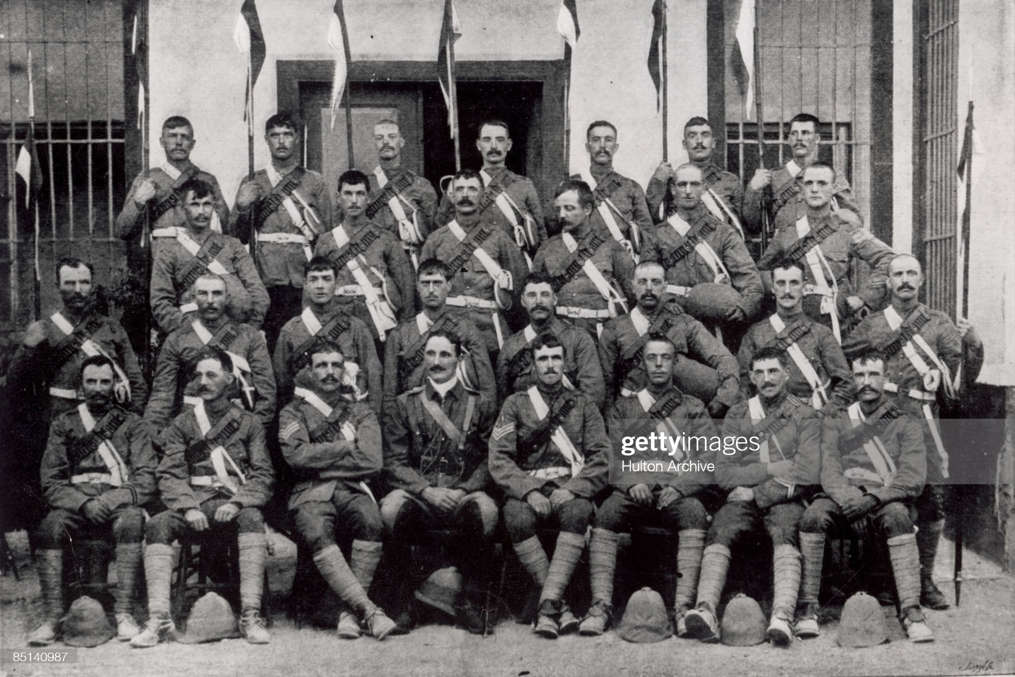
What was the goal of the battle?
The goal of the battle was to capture French.
The British needed to captured a French Redoubt and use it as a fort base to draw Montclaim out to Monitor them
Montcalm found a tactic strategy which is the art of killing to stop their plan and the British realized their process in the making soon after even if the got ahold of their objective they would be quickly overwhelmed.
Notes:
Loz did this slide

Slide 5
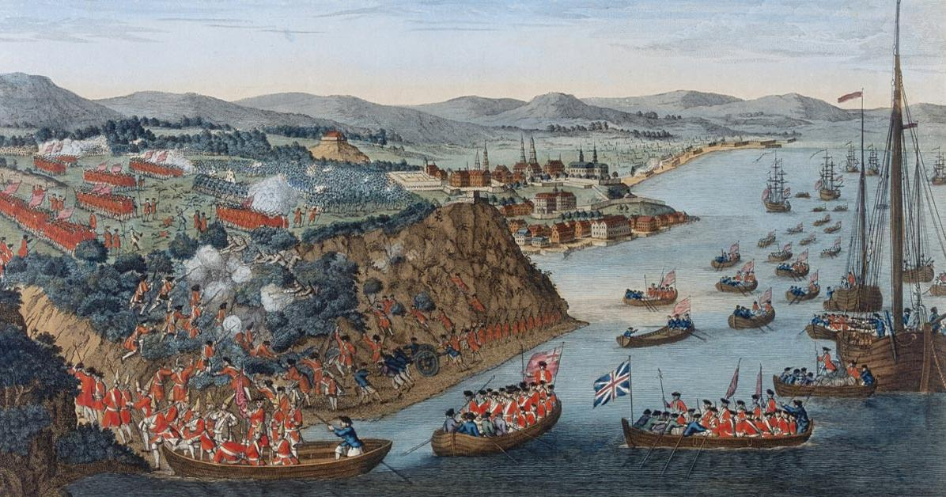
What was the significance of this battle in course of the war?
Was significant due to the fact that it significantly delayed the British evance on the French.
General Wolfe got cocky which turned out to be very costly and expensive.
Wolfe had to reevaluate what was going on and came up with a strategy that allowed him to successfully take Quebec.
This victory was critical and was the most significant part of the battle.
Notes:
Matthew did this slide

Slide 6
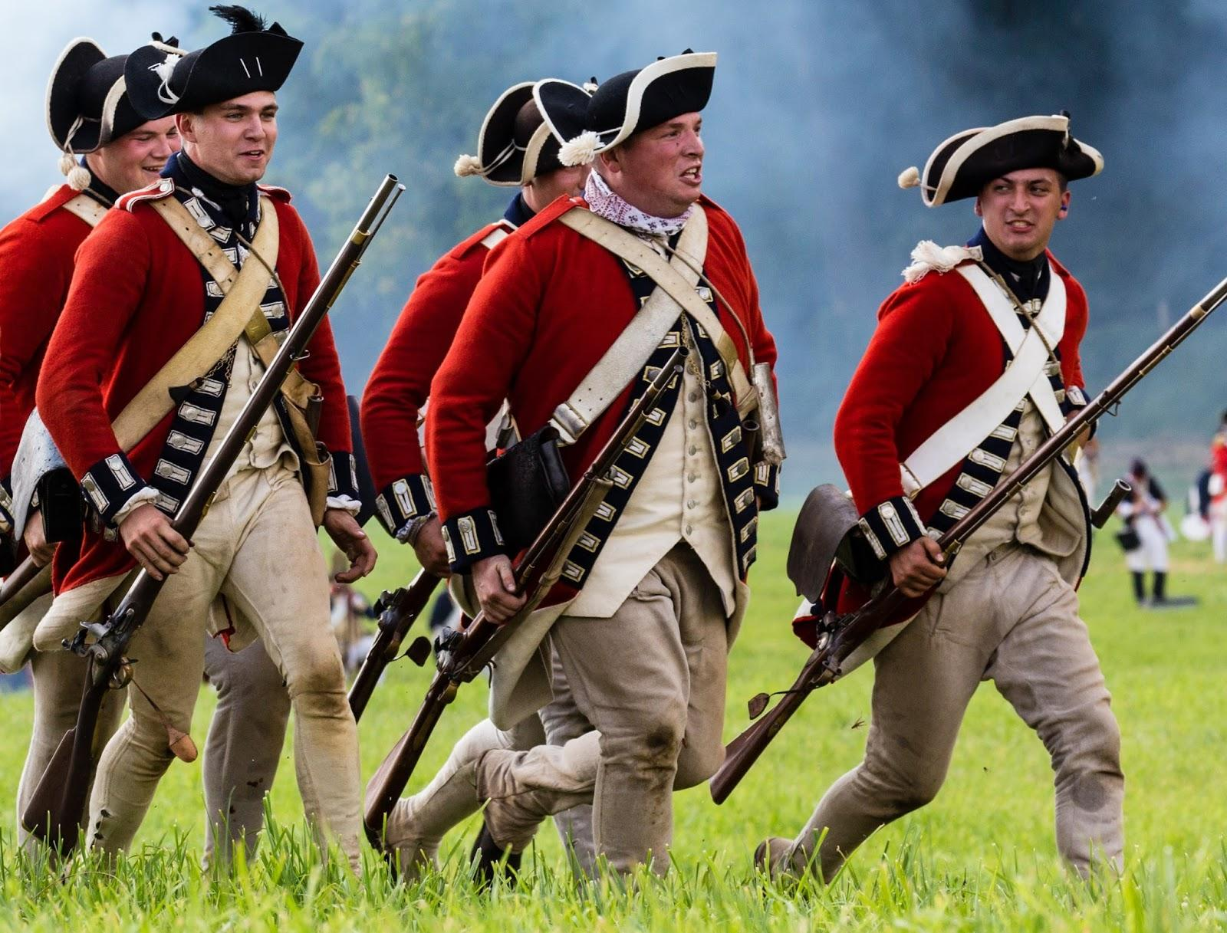
What were the effects for both slides after the battle? Who won?
The British lost and the French won
The British suffered 440 dead meanwhile the French only had 70 injured and the British surrendered
Both of the generals Montcalm and Wolfe didn't really write much about the battle ad said it was an attack that was a more important one and losses were not great
General wolfe reported 440 losses, the French lost at least 60 wounded on their side; losses which were attributed to the fire coming from the great battery of the Montmorency camp.
On the battle of Plains of Abraham Wolfe and Montcalm died in battle unexpectedly
Notes:
Loz did this slide

Slide 7
Sources
https://www.wikiwand.com/en/Battle_of_Beauport
http://bataille.ccbn-nbc.gc.ca/en/siege-de-quebec/bataille-de-montmorency/contexte.php#:~:text=The%20plan%20consisted%20in%20landing,Montcalm%20out%20of%20his%20entrenchment.
https://www.waymarking.com/waymarks/WMT50F_Battle_of_Beauport_Montmorency_QC
https://www.pc.gc.ca/apps/dfhd/page_nhs_eng.aspx?id=611#:~:text=By%20the%20time%20the%20fighting,British%20on%2018%20September%201759.
https://www.communitystories.ca/v2/portraits-de-nos-ancetres_portraits-of-our-ancestors/gallery/battle-of-montmorency-july-31-1759/
https://1.bp.blogspot.com/_WtPvmcUAYtQ/SnLnjQaLanI/AAAAAAAAANY/f19ZmNo5pM8/s400/Montmorency.jpg
https://1.bp.blogspot.com/_AOb0r-wR3yg/TKf6yZ1rzTI/AAAAAAAAAAQ/-MOO1E_yd4Y/s1600/IMG_5654.jpg
https://www.gettyimages.no/photos/battle-of-montmorency
https://www.gettyimages.de/detail/nachrichtenfoto/lieutenant-montmorency-and-troopers-of-the-21st-nachrichtenfoto/85140987
https://www.cbc.ca/history/EPCONTENTSE1EP4CH7PA5LE.html#:~:text=On%20the%20morning%20of%20Tuesday,earlier%20at%20Louisbourg%20and%20won.
https://www.battlefields.org/sites/default/files/styles/social_media/public/Battle-of-Quebec-Landscape.jpg?h=ba8f3451&itok=q9jSLlPL
Notes:
Sources Slide: Loz and Matthew did this

